Slide 1


Unit 6.1 – Project Management Process

Slide 2

Unit Goal
Describe what project management is and discuss key elements of the project management framework

Slide 3

Why do I need Project Management?

Slide 4
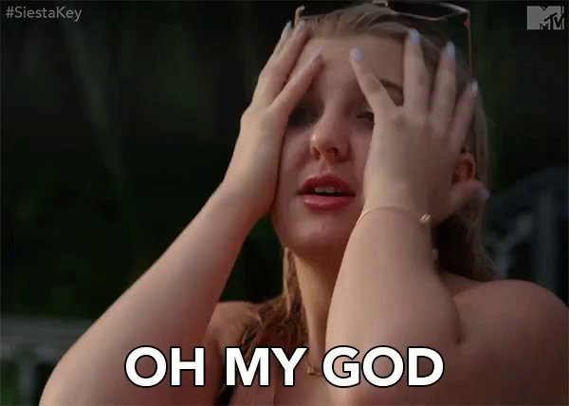
Motivation for Studying Information Technology (IT) Project Management
IT projects have a terrible track record: only 16.2% of IT projects were successful and over 31% were canceled before completion, costing over $81 B in the U.S. alone.
1995 Standish Group study (CHAOS)

Slide 5
What is a Project?

Slide 6

What is a Project?
A project is “a temporary endeavor undertaken to accomplish a unique product or service” (PMBOK® Guide 2000, p. 4)
unique purpose
temporary
require resources, often from various areas
should have a primary sponsor and/or customer
involve uncertainty

Slide 7

Project Constraint
Scope goals: What is the project trying to accomplish?
Time goals: How long should it take to complete?
Cost goals: What should it cost?
It is the project manager’s duty to balance these three often competing goals.

Slide 8
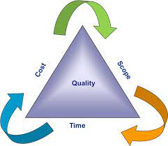

Project Constraint

Slide 9
What is Project Management?
Project management is “the application of knowledge, skills, tools, and techniques to project activities in order to meet project requirements”
(PMBOK® Guide, 2017,6th. Ed.)
www.pmi.org

Slide 10

Project Management Process

Slide 11
Software Development Process
Software Specification
Software Design & Implementation
Software Validation
Software Evolution
A software process is a set of related activities that leads to the production of a software product.
Notes:
1. Software specification The functionality of the software and constraints on its operation must be defined.
2. Software design and implementation The software to meet the specification must be produced.
3. Software validation The software must be validated to ensure that it does what the customer wants.
4. Software evolution The software must evolve to meet changing customer needs.

Slide 12
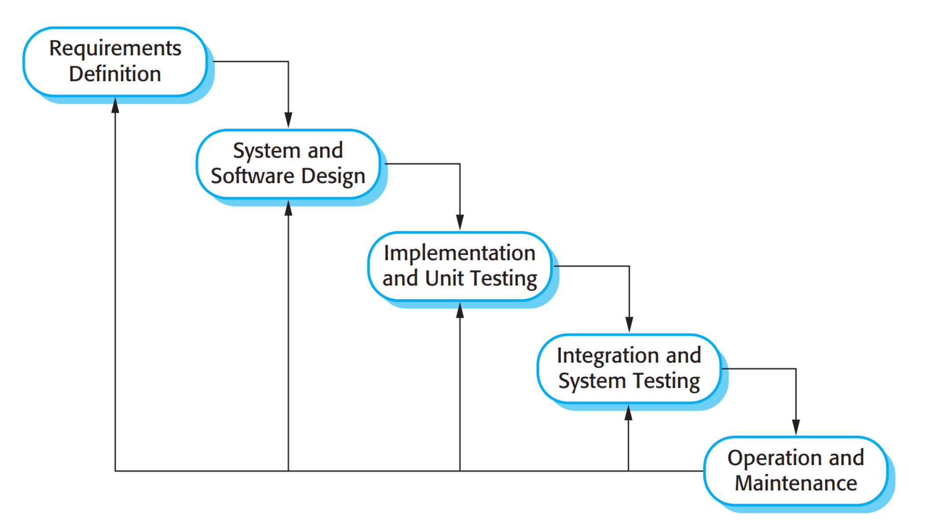
Waterfall Model
This takes the fundamental process activities of specification, development, validation, and evolution and represents them as separate process phases.

Slide 13
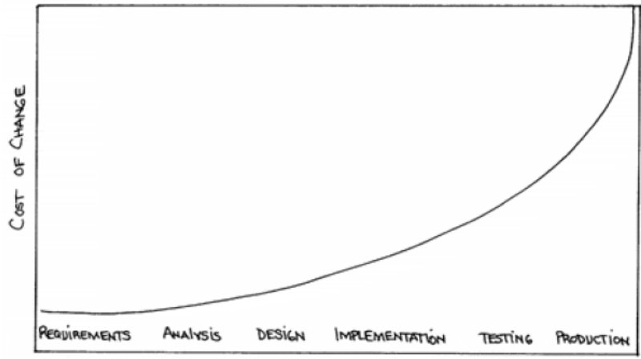
Cost of Change by Barry Boehm
BARRY, Boehm et al. Software engineering economics. New York, v. 197, 1981.
Source: http://bls.buu.ac.th/~s55103/00CourseResource/Boehm-SE-Economics.pdf

Slide 14
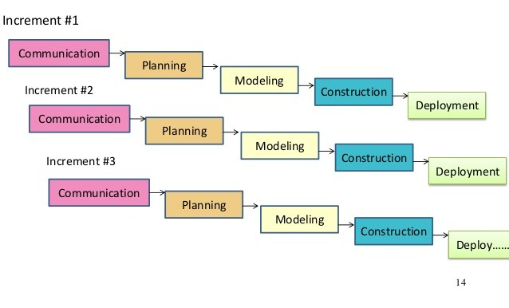
Incremental Model
It is based on the idea of developing an initial implementation, expo-sing this to user comment and evolving it through several versions until an adequate system has been developed

Slide 15
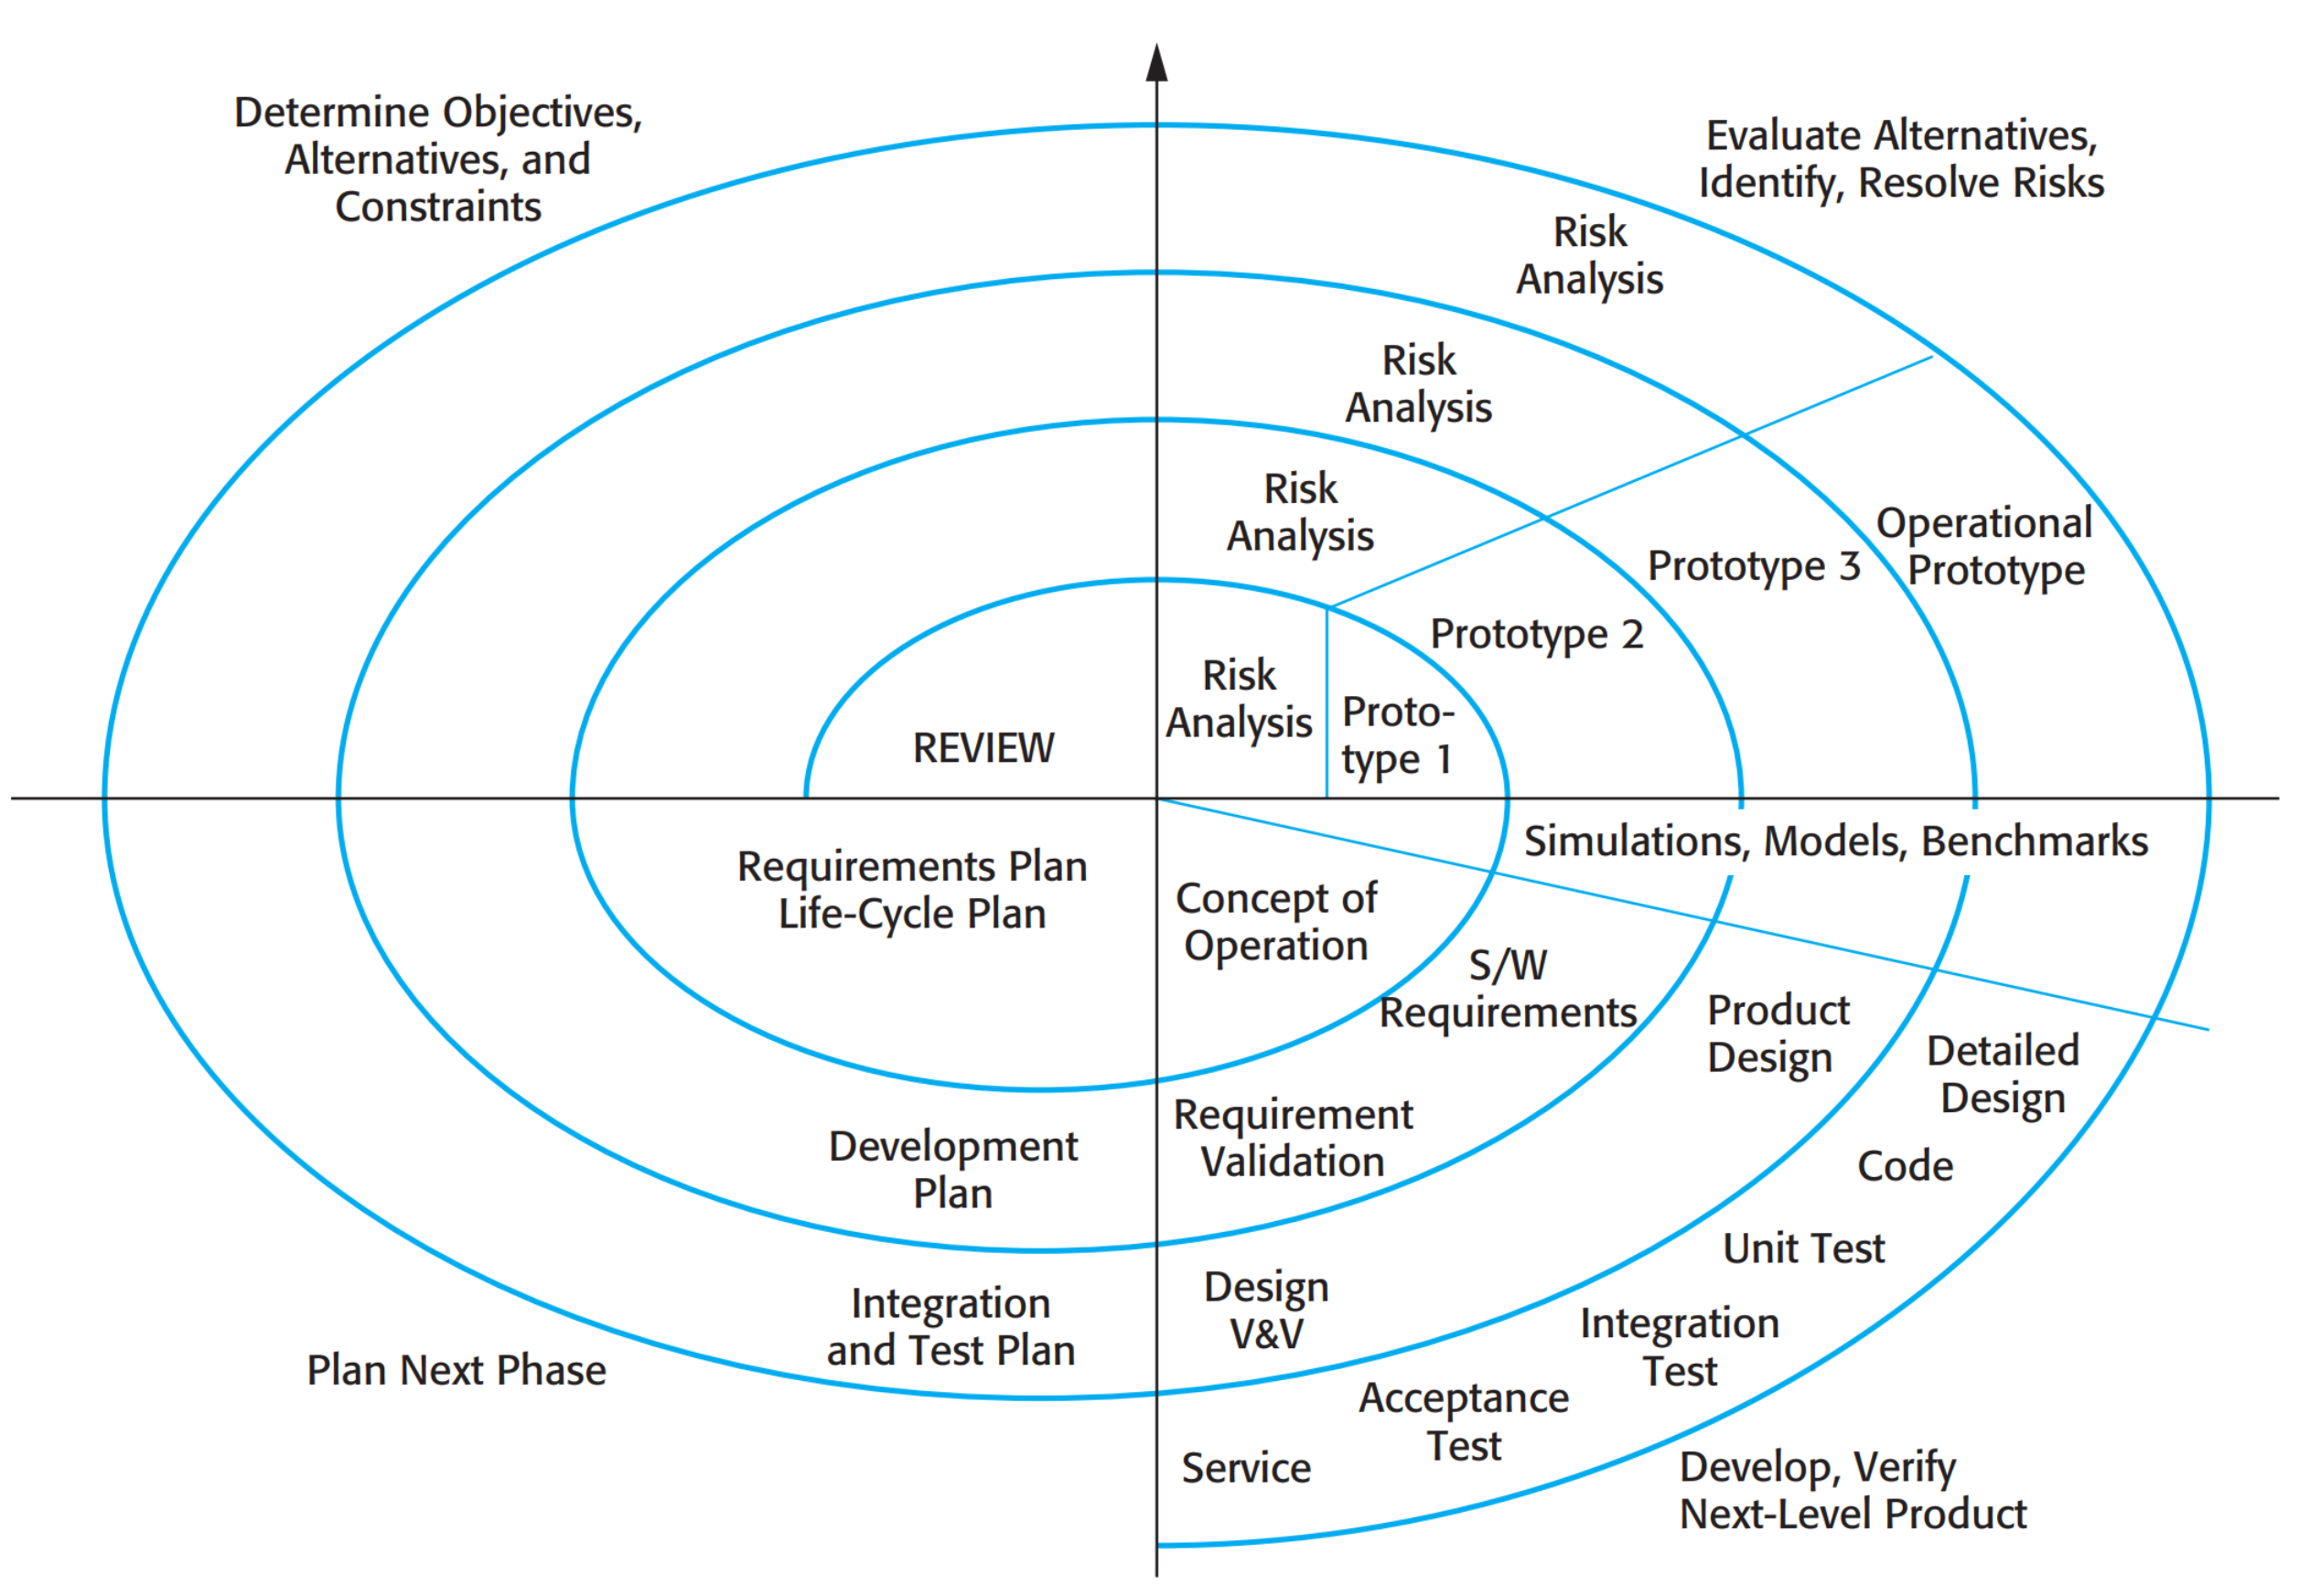
Boehm’s Spiral Model
The process is represented as a spiral, rather than a sequence of activities with some backtracking from one activity to another. Each loop in the spiral represents a phase of the software process.

Slide 16
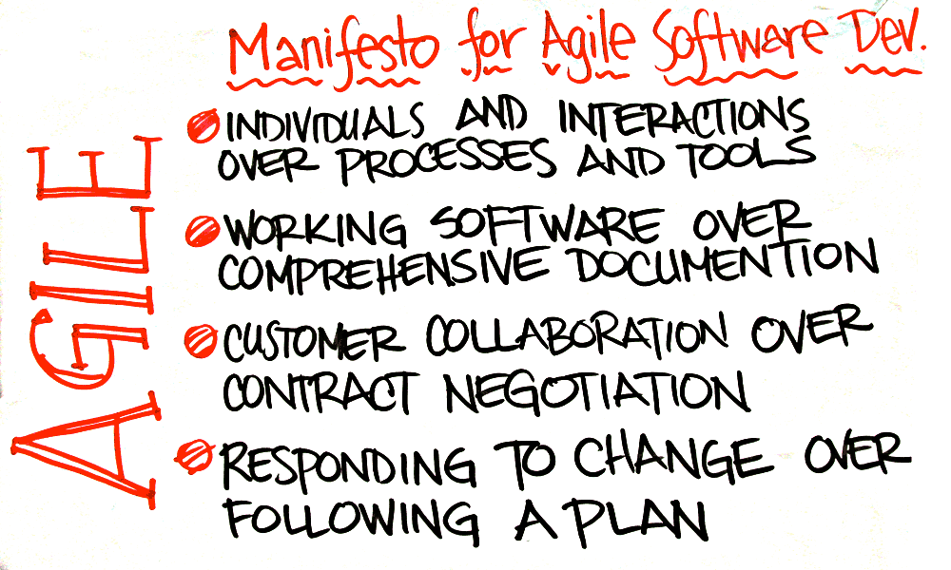

Slide 17
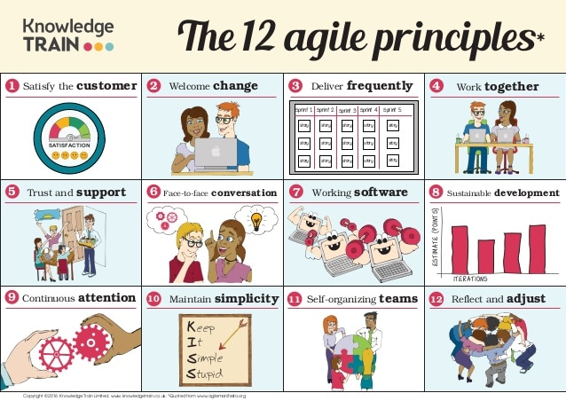

Slide 18
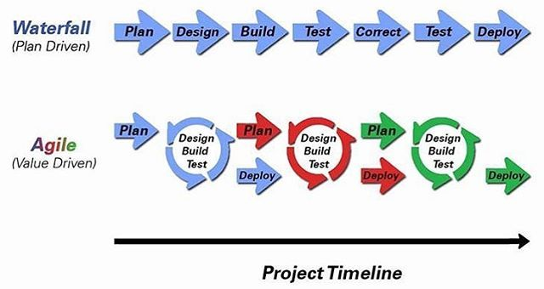
Agile x Waterfall

Slide 19
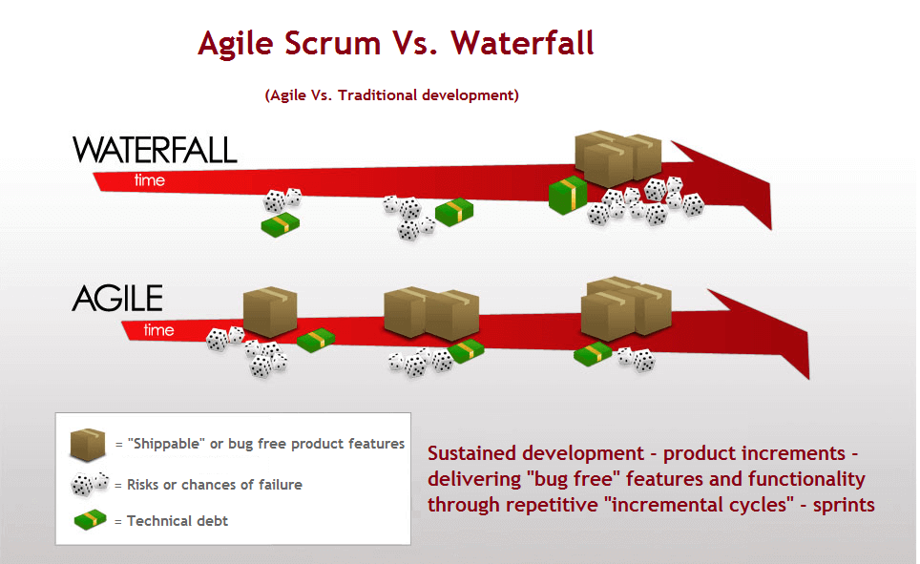
Agile x Waterfall

Slide 20
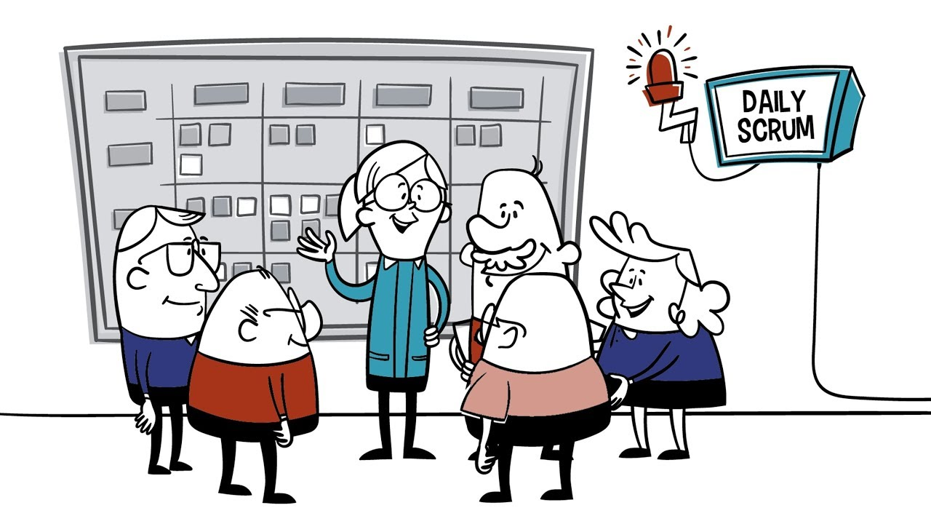
SCRUM Foundations

Slide 21
Scrum Characteristics
Self-organizing teams
Product progresses in a series of month-long (SPRINTS)
Requirements are captured as items in a list of “product backlog”

Slide 22
Scrum Characteristics
No specific engineering practices prescribed
Uses generative rules to create an agile environment for delivering projects
One of the “agile processes”

Slide 23
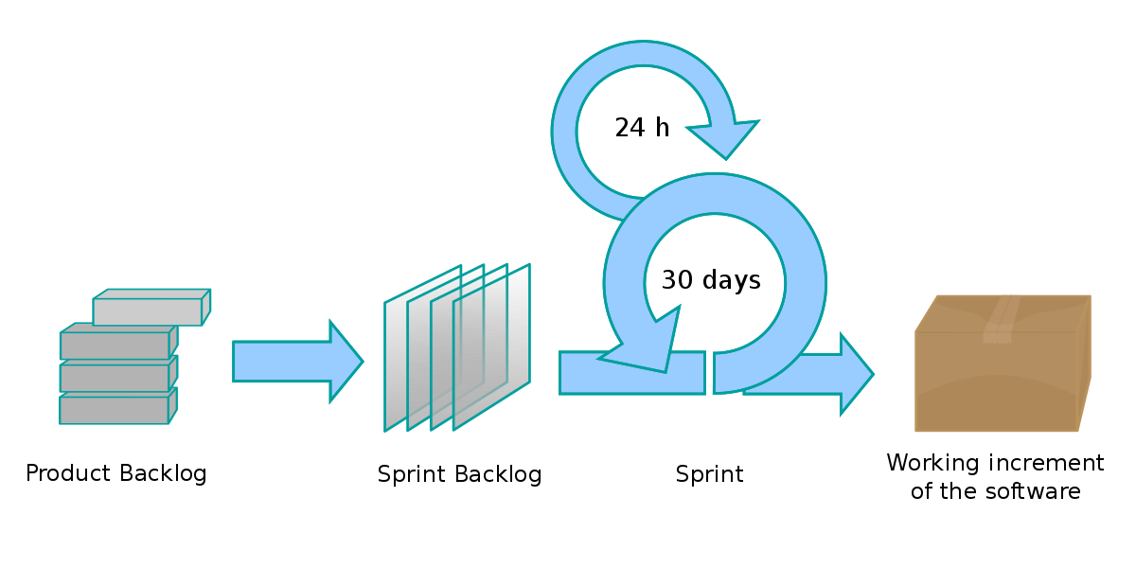
SCRUM
Sprint Goal

Slide 24
SCRUM
Planning Meeting
Sprint Goal

Slide 25
SCRUM
Daily Meeting
What did you do yesterday?
What will you do today?
Are there any impediments?
Sprint Goal

Slide 26
SCRUM
demo
No PowerPoint
Members and other visitors
Sprint Review
Sprint Goal

Slide 27
SCRUM
problems and successes
what should we keep doing
what should we stop doing
what should we start doing
Retrospective
Sprint Goal

Slide 28
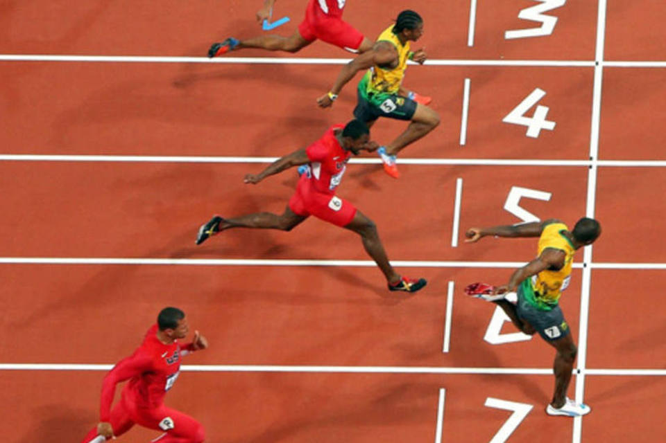
SCRUM SPRINT
It is a set period of time during which specific work has to be completed and made ready for review.
Typical duration is 2–4 weeks or a calendar month at most
A constant duration leads to a better rhythm
Product is designed, coded, and tested during the sprint

Slide 29

No changes are made that would endanger the Sprint Goal;
Quality does not decrease;
The Product Backlog is refined as needed; and,
Scope may be clarified and renegotiated with the Product Owner as more is learned.
SPRINT

Slide 30

SCRUM Roles

Slide 31

Product Owner (PO)
Define the features of the product
Decide on release date and content
Be responsible for the profitability of the product (ROI)
Prioritize features according to market value
Adjust features and priority every iteration, as needed
Accept or reject work results

Slide 32

Scrum Master
Represents management to the project
Responsible for enacting Scrum values and practices
Removes impediments
Ensure that the team is fully functional and productive
Enable close cooperation across all roles and functions
Shield the team from external interferences
HE IS NOT A BOSS!!!

Slide 33

Scrum Team
Typically: 5-9 people
Cross-functional: Programmers, testers, user experience designers, etc.
Members should be full-time
May be exceptions (e.g., database administrator)
Teams are self-organizing: Ideally, no titles but rarely a possibility
Membership should change only between sprints

Slide 34
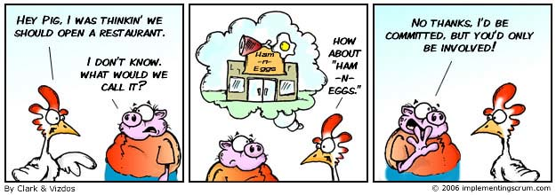
Scrum Team

Slide 35
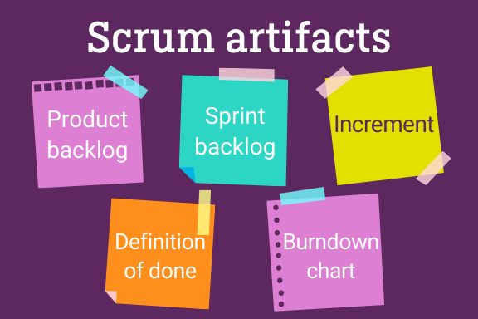
Project Initialization

Slide 36
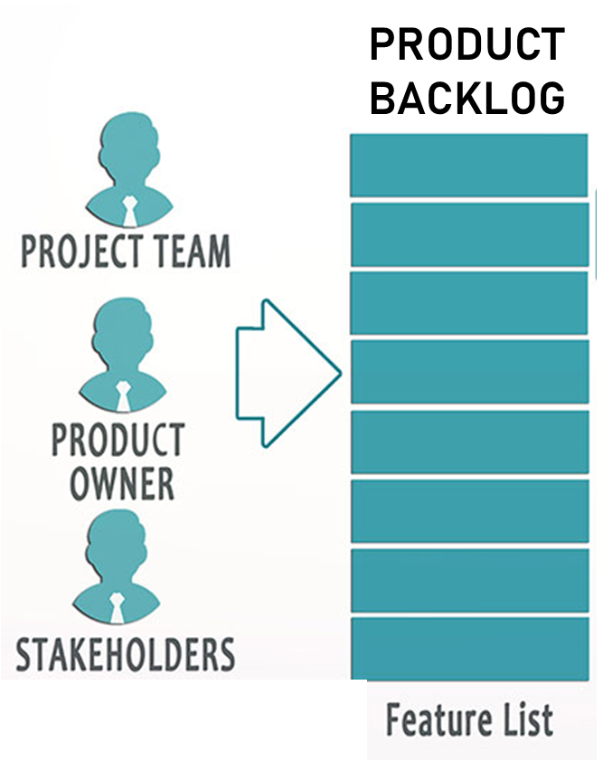
Product Backlog
The requirements
A list of all desired work on the project
Ideally expressed such that each item has value to the users or customers of the product
Prioritized by the product owner (PO)
Reprioritized at the start of each sprint

Slide 37
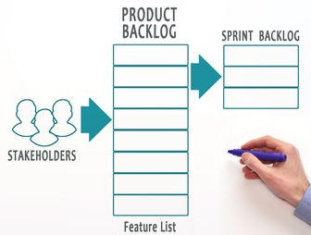
Sprint Backlog
List of tasks identified by the Scrum team to be completed during the Scrum sprint.
Most teams also estimate how many hours each task will take someone on the team to complete.

Slide 38

Sprint Goal
Life Sciences
Support features necessary for population genetics studies.
Database Application
A short statement of what the work will be focused on during the sprint.
Make the application run on SQL Server in addition to Oracle.
Financial services
Support more technical indicators than company ABC with real-time, streaming data.

Slide 39
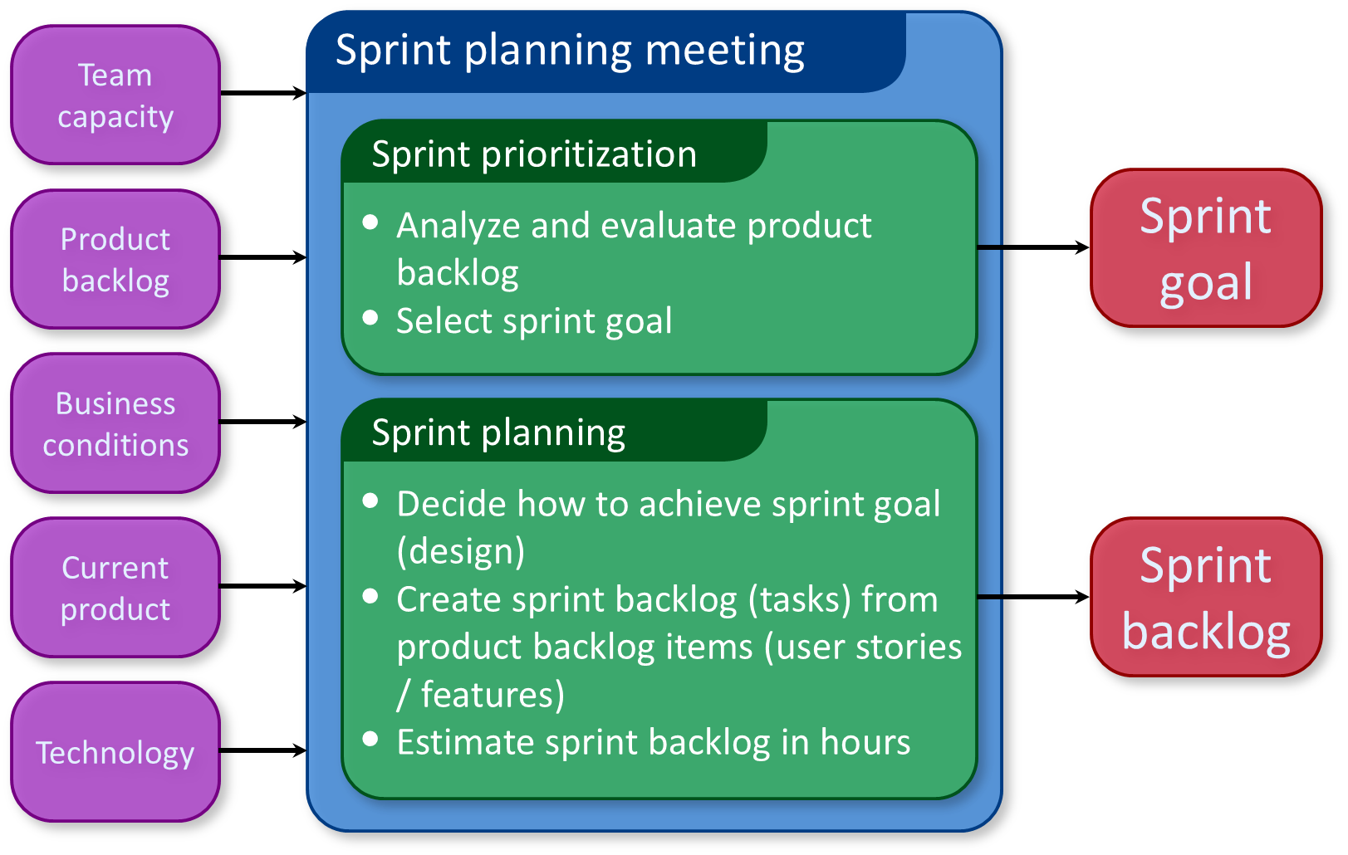

Slide 40
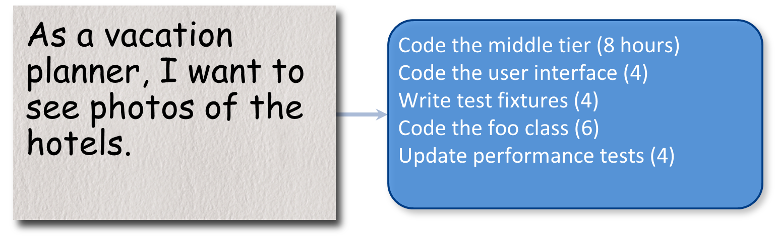
Sprint Planning

Slide 41
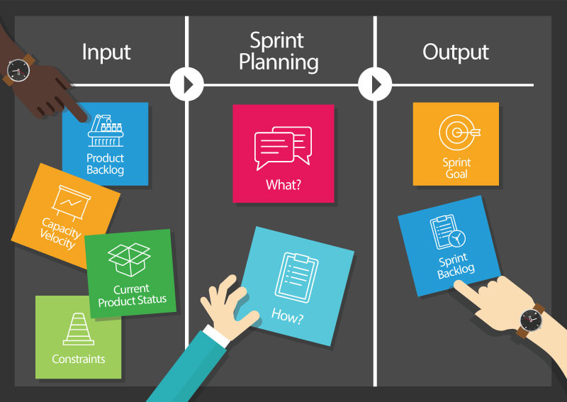
Sprint Planning
Team selects items from the product backlog they can commit to completing
Sprint backlog is created
Tasks are identified and each is estimated (1-16 hours)
Collaboratively, not done alone by the ScrumMaster
High-level design is considered

Slide 42
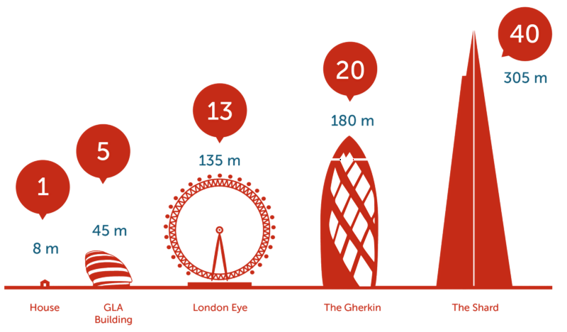
Story Points
You can use any measure to give story points (It’s flexible according to the team’s comfort level as Agile is based on flexibility and adaptability).
You can use numbers ranging from 1 to 10; numbers in powers of 2 (1, 2, 4, 8, 16, etc.); Fibonacci series, etc.

Slide 43

Story Points
A story point corresponds approximately to 1 ideal man/day (8h work).

Slide 44

Daily Scrum

Slide 45
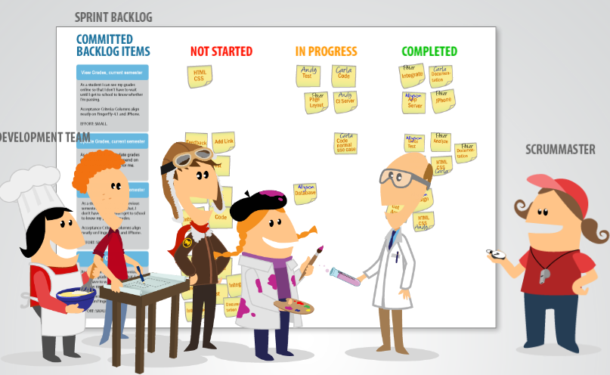
Daily SCRUM Meeting
Parameters: Daily, 15-minutes, and Stand-up
Not for problem solving
Whole world is invited
Only team members can talk
Helps avoid other unnecessary meetings

Slide 46


Everyone answers 3 questions
1
What did you do yesterday?
2
What will you do today?
3
Is anything in your way?
These are not status for the ScrumMaster
They are commitments in front of peers

Slide 47

https://www.youtube.com/watch?v=oHcmLKroPqw&t=10s

Slide 48
The Other ceremonies

Slide 49
Sprint Review
Team presents what it accomplished during the sprint
Typically takes the form of a demo of new features or underlying architecture
Informal: 2-hour prep time rule; and No slides.
Whole team participates
Invite the world

Slide 50
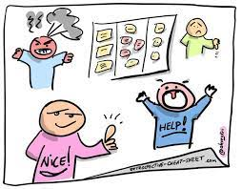
Sprint Retrospective
Periodically look at what is and is not working
Typically: 15–30 minutes
Done after every sprint
Whole team participates: ScrumMaster, Product owner, Team, and Possibly customers and others

Slide 51



Sprint Retrospective
Whole team gathers and discusses what they’d like to:

Slide 52
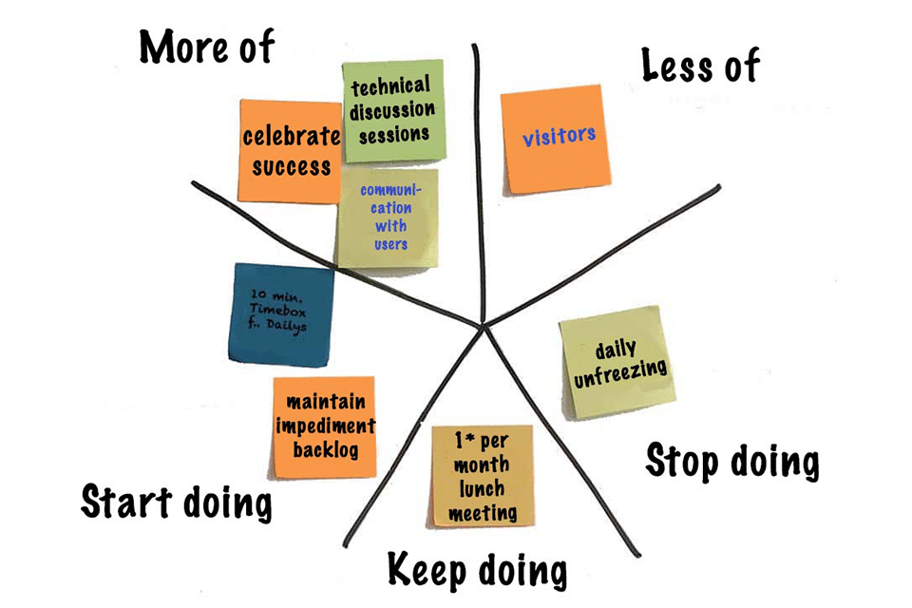
Sprint Retrospective

Slide 53
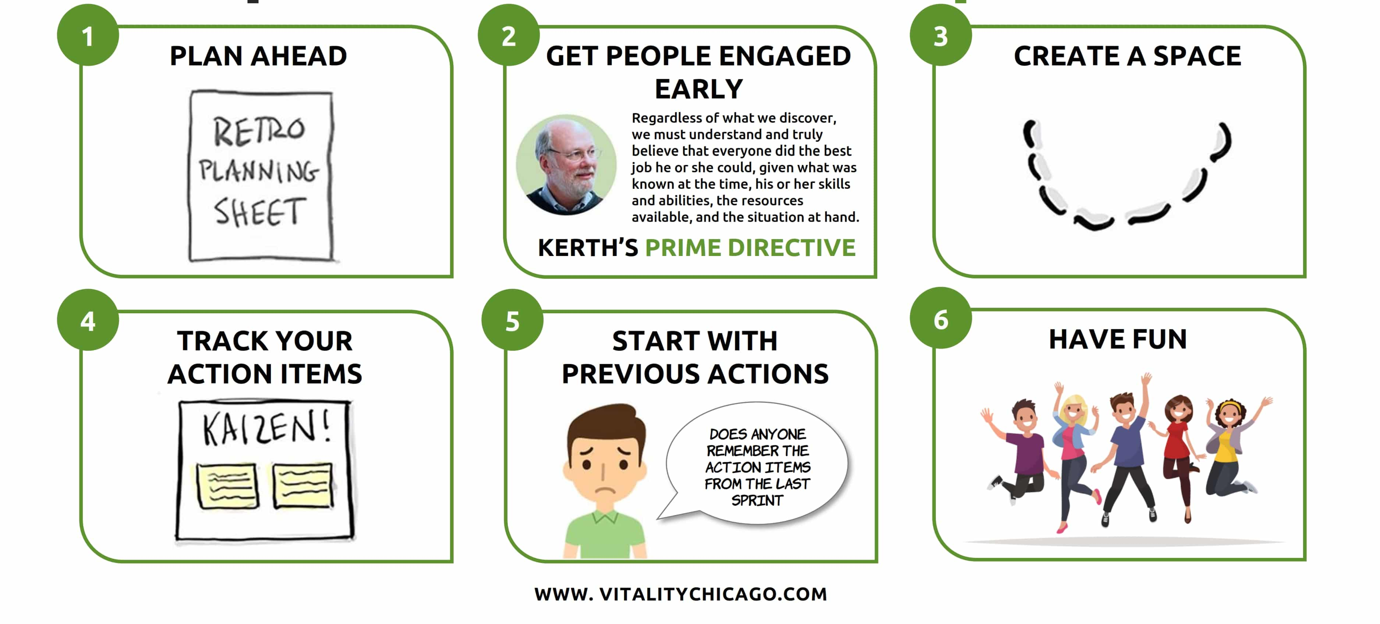
Retrospective Tips
Notes:
https://vitalitychicago.com/blog/retrospective-tip-sheet/

Slide 54

https://www.youtube.com/watch?v=GivcWpDRlD4

Slide 55
Unit 6.1 – Project Management Process

